Slide 1
HTML-CSS-JS Assessment
Stage 1: Wireframe
Team Members: Jake, Jun, Vonmichael, Ravi

Slide 2
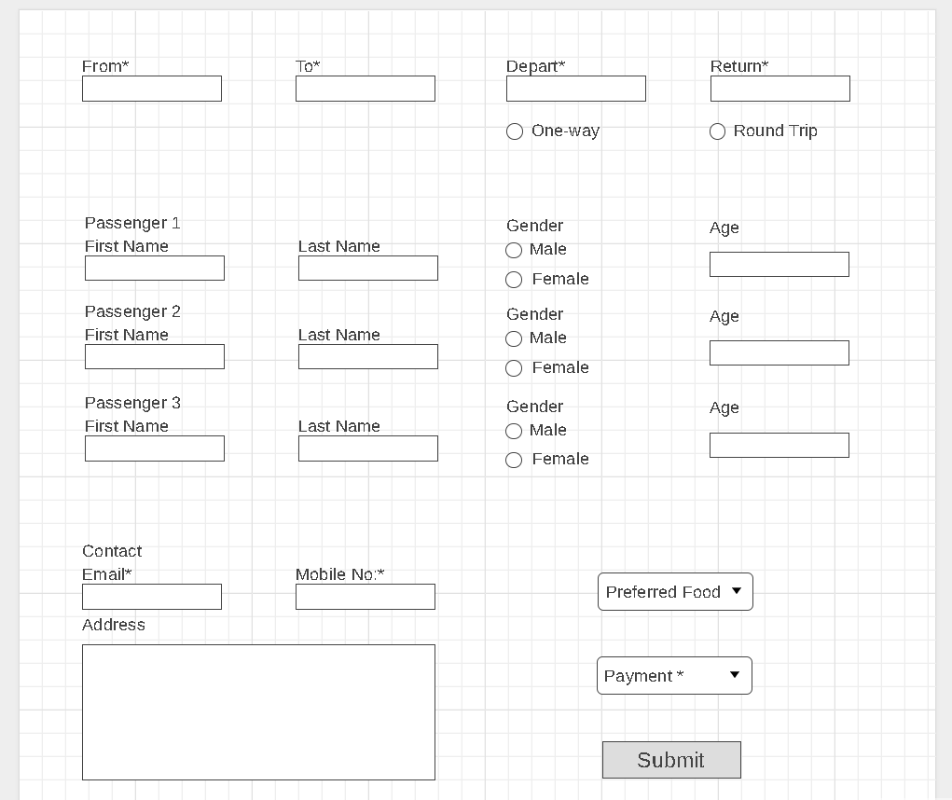
Customer Details Form

Slide 3

Confirmation Page

